Slide 2
TABLE OF CONTENTS
Introduction
Abstract
Concept Description
Problems in existing system
Proposed System
Components
Working
Use case Diagram Admin
Technologies Used
Advantages and Disadvantages of Project
Features
Conclusion
Bibliography

Slide 3
INTRODUCTION
In the age of artificial intelligence and deep learning, Computer Science has had a lot of advancements in the past decade, and AI seems to definitely stands out distinguished among them. A chat bot is an artificial intelligence (AI) software that can simulate a natural language conversation (or chat) with a user via messaging applications, websites and mobile apps, or by telephone. The business-to-consumer aspect of electronic commerce is the most visible business use of the World Wide Web. The primary goal of an e-commerce site is to sell goods and services online. This project deals with developing an AI based chat bot that negotiates the price with the different customers in an e-commerce market site. AI based automated negotiation can give a flexible price instead of a fixed price in e-commerce, and can maximize the pay-offs of both buyer and seller. It can be seen as an ideal and efficient mechanism for business. There are three main approaches for automated negotiation: the decision theory, the game theory and the negotiation analysis. Then, give a view of some famous models. Finally, we point out that the automated negotiation is still in its infant stage, because there are still some difficulties in this field.

Slide 4
Abstract
This paper describes an e-commerce website based AI chat bot. This chat bot can make it easier to interact and negotiate the price within the e-commerce website. The chat bot understands and converses with the user in simple language. This chat bot is integrated to an online market site. This website has a variety of products across the aisle. The chat bot helps you to purchase a product which is suitable for you at a negotiated price. This is especially helpful when you don’t have sufficient funds for the product you planning to purchase. Its function basically like a third party mediator between the buyer and the seller.

Slide 5
Concept Description
Admin
Login: Admin need to login by providing the login credentials to access the below given admin modules.
Add / View Product: Admin can enter details about new products details and view its details.
View Order: Admin can view details about the order placed by the user.
View Users Details: Admin can view all the registered user’s details.
User
Login/Registration: User can register on the system and get his online account on site.
Chat Bot: Automated negotiation model can learn from experience in negotiation, reason, and give a reasonable choice of negotiations on a new strategy. User can chat with the bot for price negotiation for a particular product.

Slide 6
PROBLEMS IN EXISTING SYSTEM
In Existing System, the Customer is completely depending on the manual process for buying the product.
Manual process is a time consuming factor and when customer approaches for a manual shopping directly, actually he/she does not have an idea about things like, price range, etc….
While online payment using card, the card details are stored as it is into the database without any encryption.
There is a possibility of card details getting hacked.
The time which has been spent by the customer in manual shopping can equates to multiple number of shopping. As customer can sit at home and browse in a fraction of seconds.
The system is limited to a particular area as the store generally caters the need of people living in a particular territory.
Customers have to take pain to go to the shop in case of heat, cold, rain etc.
No common platform and easy facility normally available where many dealers can interact with one as many stores have products of just one particular company or dealer.
Thus, we need to change to a system like “Online Shopping”.

Slide 7
PROPOSED SYSTEM
Considering the anomalies in the existing system computerization of the whole activity is being suggested after initial analysis.
The web application is developed using Visual Studio with Asp .Net with C# as a programming language.
Proposed system is accessed by two entities namely, Admin and User.
Admin need to login with their valid login credentials first in order to access the android application.
After successful login, admin can access all the modules and perform/manage each task accurately.
Admin can perform task such as adding new product with its details and viewing added product details, viewing order details and user details.
User need to register using basic registration details and need to create valid login id and password.
User can login using valid login credentials in order to access the system.
User can view products and chat with the AI bot for price negotiation for a particular product.
After negotiation, user can buy the product from the website and pay.

Slide 8
COMPONENTS
The two major components are the website and the chat bot. They are integrated seamlessly to provide a smooth user experience.
1. Simple : Responses are coded in plain text file. No complicated syntax.
2. Powerful : It has a handful of rule that can be combined to build a fairly impressive chat bot.
3. Flexible : Rive script follows the Unix philosophy: the core library is focused on rendering responses, while also leaving enough scope for extensibility by ways of custom modules and scripts.
4. Open Source : Rive script is released in the MIT license, and are available on popular platforms such as Perl, Python, Javascript and even C#

Slide 9
WORKING
User: Hello
Bot: Hello there. How can I help you?
User: Price is high.
Bot: Can you share the item name
User: Black Stripe Shoe
Bot: What’s your offer?
User: 50Rs.
Bot: That’s too low, I can suggest you alternatives at that price range are you interested?

Slide 10
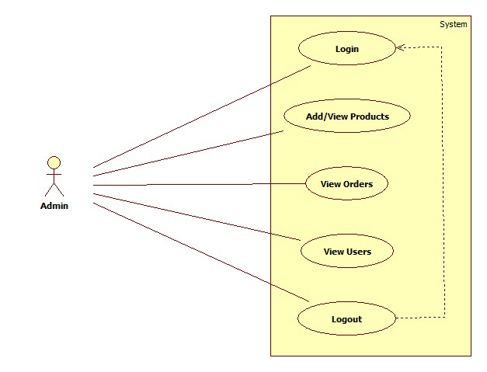
USE CASE DIAGRAM ADMIN

Slide 11
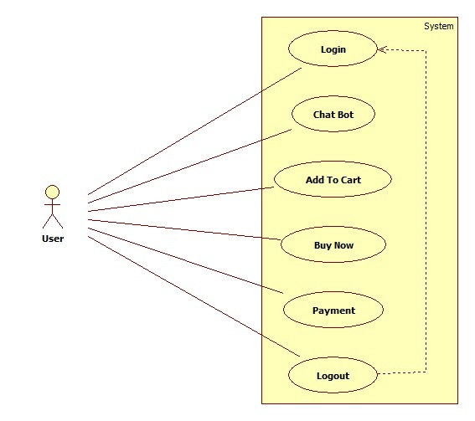
Use Case Diagram of User

Slide 12
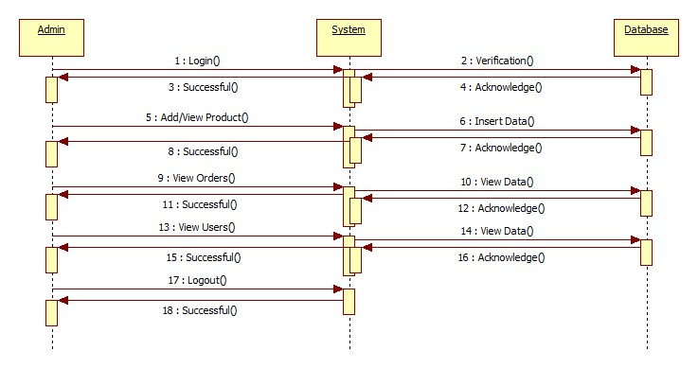
Sequence Diagram of Admin

Slide 13
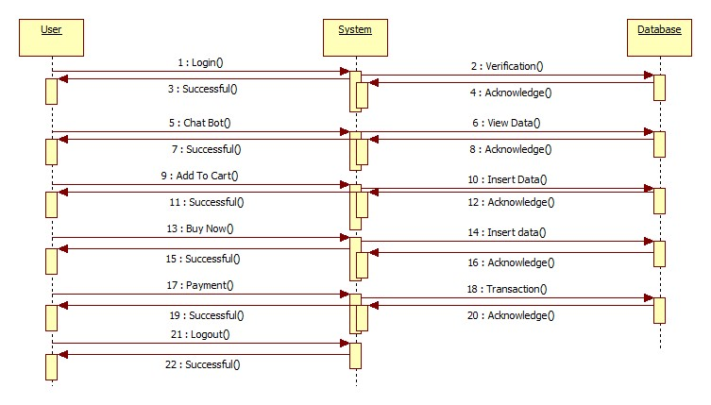
Use Case Diagram of User

Slide 14
TECHNOLOGIES USED
Front End Technology
Microsoft .NET Framework
Console applications.
Scripted or hosted applications.
Windows GUI applications (Windows Forms).
ASP.NET applications.
XML Web services.
Windows services.

Slide 15
TECHNOLOGIES USED
BACK END TECHNOLOGY
Microsoft SQL Server
Relational Database
Client/Server:
Structured Query Language (SQL)

Slide 16
ADVANTAGES OF PROJECT
Helps shops to automate selling online.
Consumers can negotiate with the AI Bot with respect to product price.
After price negotiation, payment link with negotiated price is sent over mail to consumer.
Helps shops to take cc payments.
Provides email confirmation on payment success.

Slide 17
Disadvantage:
It requires active internet connection else, error may occur.
Does not keep track of stock.
Application
This system can be used in single shop.
This system can be used to sell like chain of furniture shops from a single site.

Slide 18
FEATURES
Load Balancing:
Since the system will be available only the admin logs in the amount of load on server will be limited to time period of admin access
Easy Accessibility:
Records can be easily accessed and store and other information respectively.
User Friendly:
Efficient and reliable:
Maintaining the all secured and database on the server which will be accessible according the user requirement without any maintenance cost will be a very efficient as compared to storing all the customer data on the spreadsheet or in physically in the record books.
Easy maintenance:
Price Negotiating with Chat Bot website is design as easy way. So maintenance is also easy.

Slide 19
CONCLUSION
This was our project of System Design about “Price Negotiating with Chat Bot” is a web application based on Asp .Net language. The Development of this system takes a lot of efforts from us. We think this system gave a lot of satisfaction to all of us. Though every task is never said to be perfect in this development field even more improvement may be possible in this application. We learned so many things and gained a lot of knowledge about development field. We hope this will prove fruitful to us.

Slide 20
BIBLIOGRAPHY
Websites:
en.wikipedia.org
Microsoft Developer Network (MSDN): http://msdn2.microsoft.com/en-us/default.aspx: This is a valuable online resource, and is a must for any developer using Microsoft tools.
http://www.asp.net/: This is the official Microsoft ASP.NET web site. It has a lot of: tutorials, training videos, and sample projects.
http://ijcsit.com/docs/Volume%206/vol6issue02/ijcsit20150602125.pdf
https://www.brihaspatitech.com/blog/custom-shopify-app-chat-bot-powered-price-negotiator/
https://ecommerce-chatbots.com/

